Slide 1
OrderMaster
Denver Woolard, Harrison Aunspaw, Robert Sutton, Romel Miller, Lydia Clark

Slide 2
OrderMaster’s Goal
OrderMaster is a simple, intuitive program that allows owners and employees of a restaurant business to manage their orders. It also has functionality to manage servers or waiters, menu items, and tables.

Slide 3
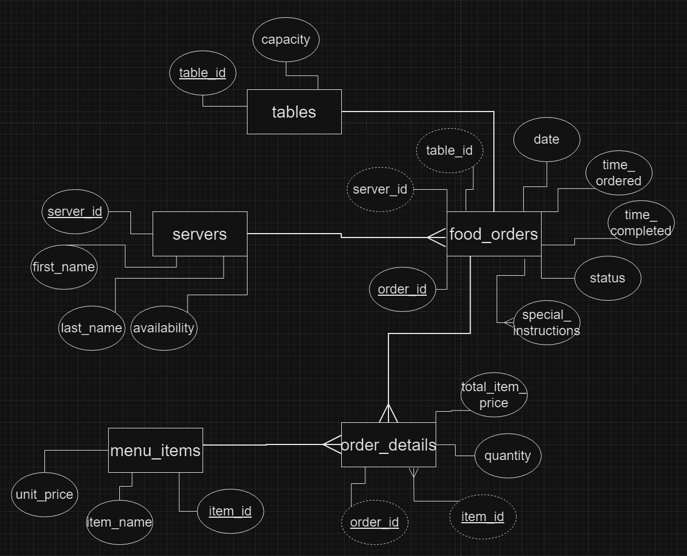

Slide 4
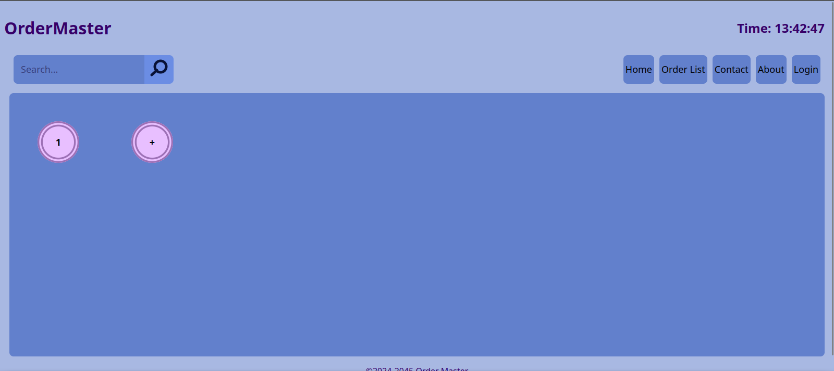

Slide 5
